Slide 1
UAE E-Invoicing Enablement Building the Operating Model for the UAE Vision 2031

Slide 2
“
The UAE’s Vision 2031 is not only redefining regulation, it is reshaping how enterprises operate, transact and govern data. E-invoicing is a foundational pillar of this vision, designed to move the economy toward transparency, real-time reporting and digitally native finance. This transition is not a tax initiative in isolation. It represents a structural shift in enterprise operating models, impacting ERP design, transaction flows, controls, data ownership and decision-making across Finance, Tax, IT and Operations.
The UAE’s 5-corner decentralized e-invoicing model is among the most advanced globally and distinct within the GCC. Its architecture places responsibility, validation, and accountability across multiple stakeholders in real time, making fragmented, system-by-system compliance approaches unsustainable. Success in this environment demands more than technical connectivity.
It requires:
Early impact assessment across systems and processes
Strong Tax, IT & Finance governance
Thoughtful ASP selection aligned to enterprise scale and complexity
A long-term operating model, not a short-term compliance fix
E-invoicing in the UAE is a multi-year transformation journey. Enterprises that approach it with clarity, coordination, and the right partners will not only achieve compliance, they will unlock faster billing cycles, stronger controls, and richer transactional intelligence.

Slide 3






Quick snapshot
1 Oct 2027
Go Live for government entities
5-corner model
1 July 2027
Go Live for Phase 2 entities
C1 - Supplier
C4 - Buyer
31 Mar 2027
Key features:
5-corner decentralised model using Peppol
Applicability: B2B & B2G
Mandatory to appoint an ASP
List of 12 pre-approved ASPs issued by the MOF
ASP appointment for Phase 2 – below 50mn & government entities
1 Jan 2027
C2 - ASP
C3 - ASP
Go Live for Phase 1 entities
31 July 2026
What has happened until now?
ASP appointment for Phase 1 – 50mn & above
C5 - FTA
1 July 2026
Pilot mode for select companies

Slide 4
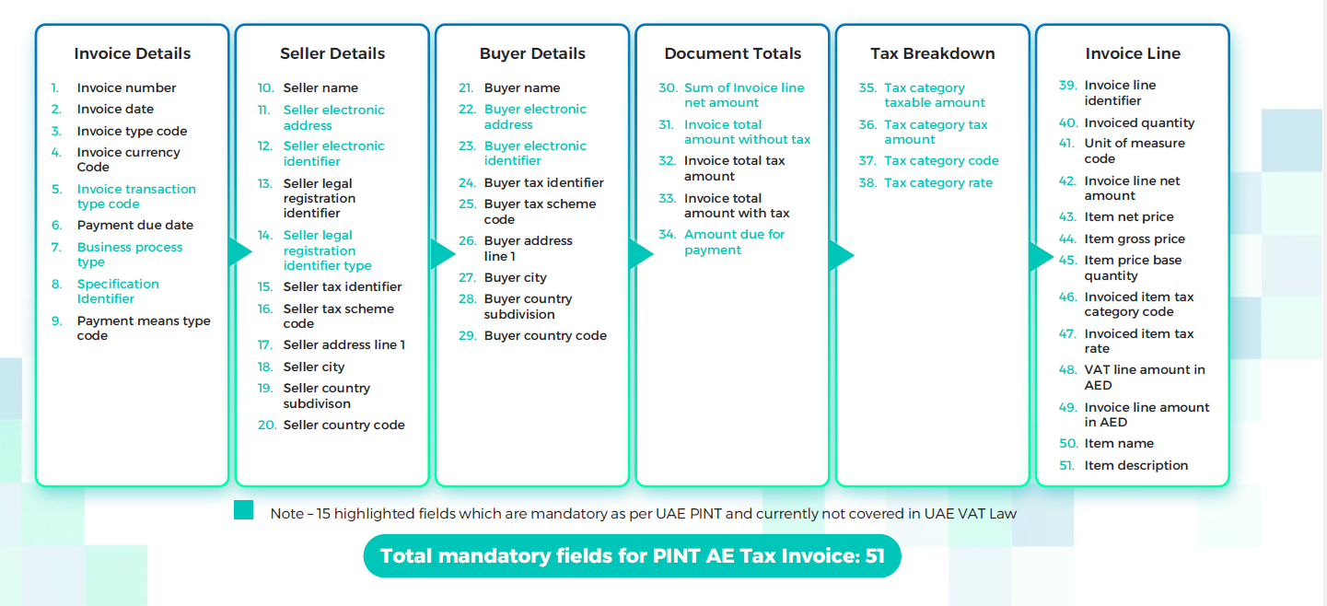
Required Fields – Standard Tax Electronic Invoice

Slide 5
Stages of e-invoicing implementation
Plugging existing VAT leakages
Use case transaction wise mapping
Step 2: ASP Selection assistance
Conducting demos with the shortlisted ASPs
Assisting with finalizing the right ASP for the company
Step 3: ERP Gap Assessment
Step 1: Tax Impact Assessment
Step 4: Integration & Testing
Step 5: Implementation and Go-Live support
This would include undertaking a gap analysis between the existing data fields in the ERP vis-à-vis the e-invoicing PINT-AE
Iidentify gaps in data model and route to remediation.
Constant support from go-live date until the filing of first VAT return.
Deploy local processes and technology solutions to enable compliance by go-live date.

Slide 6





Approach to ASP selection
Technological Capabilities
ASP should demonstrate capabilities to satisfy medium and long-term needs, through a robust infrastructure
Operability Model
ASP should be able to adapt to the different systems, transform data into the different formats & comply with local requirements (content & structure)
Data Security
ASP should demonstrate capabilities to safely manage & store client confidential data
Knowledge & Expertise
ASP should demonstrate knowledge & expertise in supporting different clients among various jurisdictions successfully
Support Model
ASP should provide a robust support model, being capable to assist the client with technological & tax technical matters

Slide 7
Key implementation challenges
Project management
A successful implementation requires a cross functional approach including IT, Finance, Tax and others.
ERP data management
Do you have enough granularity of customer/supplier information?
AR & AP Processes
In 5-corner model, e-invoicing is not only impacting the AR process.
Is Master data management reasonably accurate? What gaps exist?
E-invoicing places much greater pressure on the effective management of accurate source data.
Phased Timelines
Phased approach on the market
Integration with suppliers’ timelines
Therefore, potential changes to AP processes and systems also need to be evaluated.
As there is a direct flow to the recipient, receipt of e-invoices can lead to automation from AP perspective.
Businesses should have an implementation roadmap and governance structure early to ensure a smooth transition.

